Slide 1



Rockbuster Stealth
2020 Market Analysis
Haley Bustle, October 2023

Slide 2
Project Goals
Rockbuster Stealth LLC is a movie rental company that used to have stores around the world. Facing stiff competition from streaming services such as Netflix and Amazon Prime, the Rockbuster Stealth management team is planning to use its existing movie licenses to launch an online video rental service in order to stay competitive.
Through our analysis today, we hope to help prepare Rockbuster for an online movie rental service by providing the following information:
Define customer regions and revenues earned in each country
Define current film revenues for physical film rentals with current film library
Define top ten customers & a rewards program

Slide 3
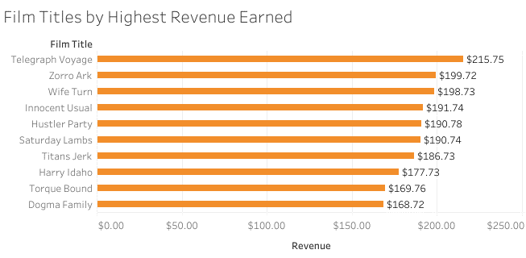
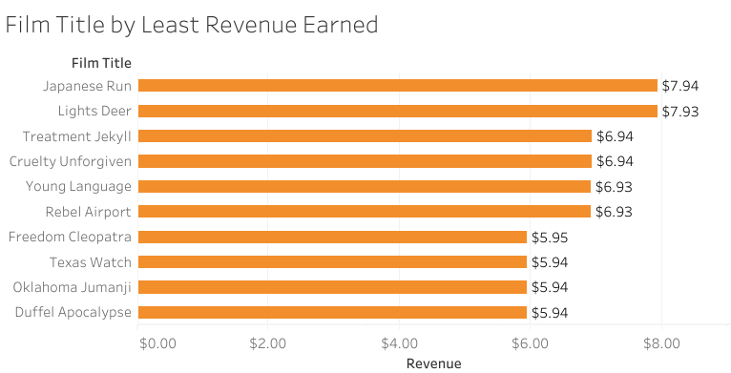
Film Revenue by Title
Top 10 earning films gross an average of $189.04 per title, with the highest earning $215.75 total.
Bottom 10 earning films gross an average of $6.74 per title, with the lowest earning just $5.94 total.
Highest earning rental rate category is $4.99/title
Rental Rate | Total Revenue
$4.99 | $29,944.19
$2.99 | $19,451.27
$0.99 | $11,916.58

Slide 4
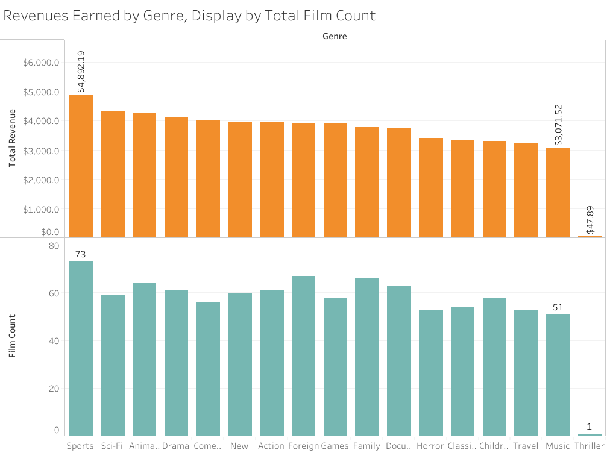
Film Revenue by Genre
Highest grossing film category is sports: 73 titles for total revenue of $4,892.19
Least grossing category is music: 51 titles for $3,071.52
Outlier film category: Thriller has 1 title and $47.89 in total revenue
Can confidently conclude that higher quantity of film titles does not always translate to higher revenue

Slide 5
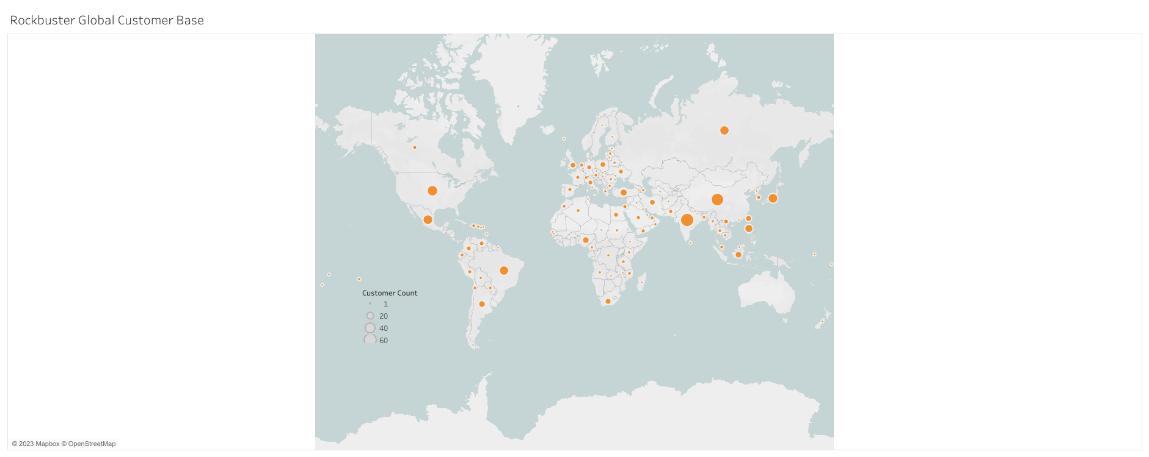
Rockbuster Global Customer Base
600 customers worldwide with the top five countries having an average of at least thirty customers
Largest customer base is Asia and (with largest population reach)
Second largest customer base is United States & India
Smallest customer base in South America, Africa, and Europe

Slide 6
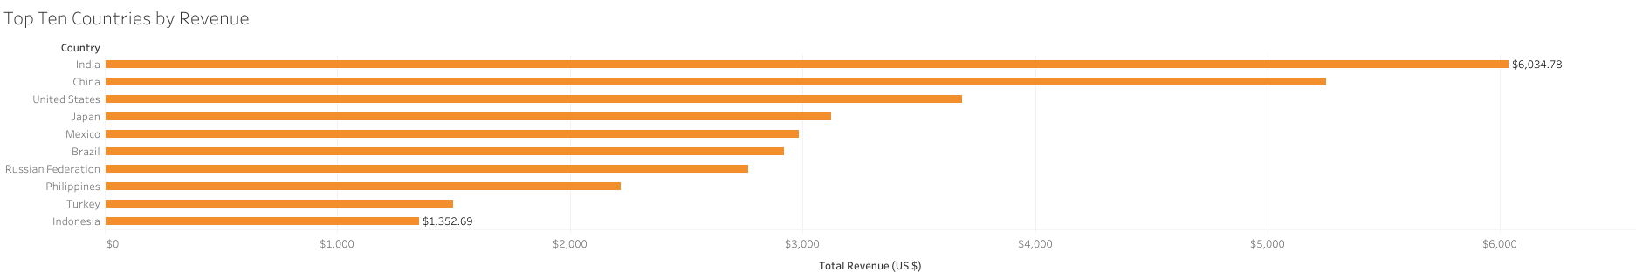
Revenue by Country
Top five countries by revenue are:
1) India, $6,034
2) China, $5,251.03
3) United States, $3,685.31
4) Japan, $3,122.51
5) Mexico, $2,984.82
Customers within top five countries:
1) India, 60
2) China, 53
3) United States, 36
4) Japan, 31
5) Mexico, 30

Slide 7
Lifetime Customers
Customer ID | Total Amount Paid ($ US) | City | Country
148 | $211.55 | Saint-Denis | Runion
526 | $208.58 | Cape Coral | United States
178 | $194.61 | Santa Brbara dOeste | Brazil
137 | $191.62 | Apeldoorn | Netherlands
144 | $189.6 | Molodetno | Belarus
459 | $183.63 | Qomsheh | Iran
181 | $167.67 | Memphis | United States
410 | $167.62 | Richmond Hill | Canada
236 | $166.61 | Tanza | Philippines
Top ten customers by total amount paid for film rentals, names redacted for security of patrons.
India is leading in total customers and total revenue earned, but has only one representative in top ten spending customers
Top ten customers spread throughout all continents, indicating possibility for further growth in United States & Europe

Slide 8
Recommendations
Further investigation should be conducted to verify accuracy of findings. Data provided for analysis was conducted in 2006 and there are several factors that could impact business decisions for 2020.
Further investigation to determine if all films are correctly categorized and thus correctly representing total revenues earned.
Define least popular films renting at $4.99 and lower the rental cost to $2.99; define most popular films renting at $0.99 and increase rate to $2.99
Study trends in these new rental rates to determine customer response (customer surveys)
Study any associated costs to licensing, ownership, or replacement costs of current film inventory and compare it to customer popularity and revenue earned. Remove all titles performing at or below cost.
Focus efforts of advertising, marketing, and customer satisfaction surveys in top 10 listed countries for online rental program
Establish a rewards program for returning customers both in physical and digital film rentals

Slide 9
Thank you!
All visuals used in this presentation are available on Tableau Public, please click here for more information.
Please contact me by email for further questions and information

